Slide 1
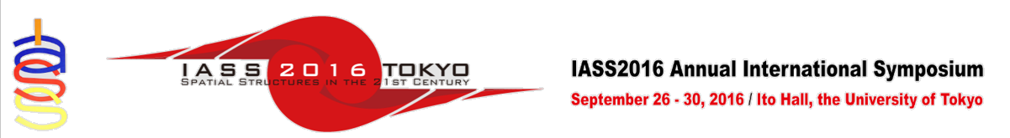
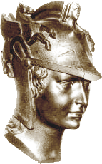

PARAMETRIC DESIGN AND OPTIMIZATION OF SHELL STRUCTURES USING THE NATURAL FORCE DENSITY METHOD
Márcio Sartorelli Venâncio de Souza
Ruy Marcelo de Oliveira Pauletti
Polytechnic School of the University of São Paulo

Slide 2
Force Density Method (FDM)
(Linkwitz & Sheck, 1974)
A system of central forces:
Force Densities:
Linear Equilibrium Equations:
External nodal loads:
Internal nodal loads:
Force densities stiffness matrix:
Nonlinear Equilibrium Equations:

Slide 3
Some isotropic solutions:

Slide 4
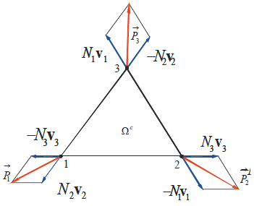
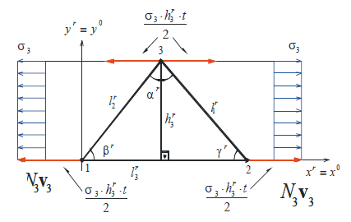
Natural Force Density Method (NFDM)
(Pauletti, 2006)
Vector of Natural Forces
Vector of internal forces,
decomposed into components parallel to the element sides
Vector of natural force densities, witch can be obtained by an initial stress field
Natural force densities stiffness matrix

Slide 5
Membrane solutions:

Slide 6
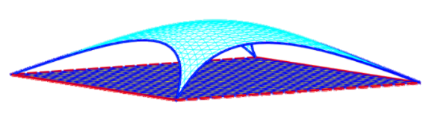
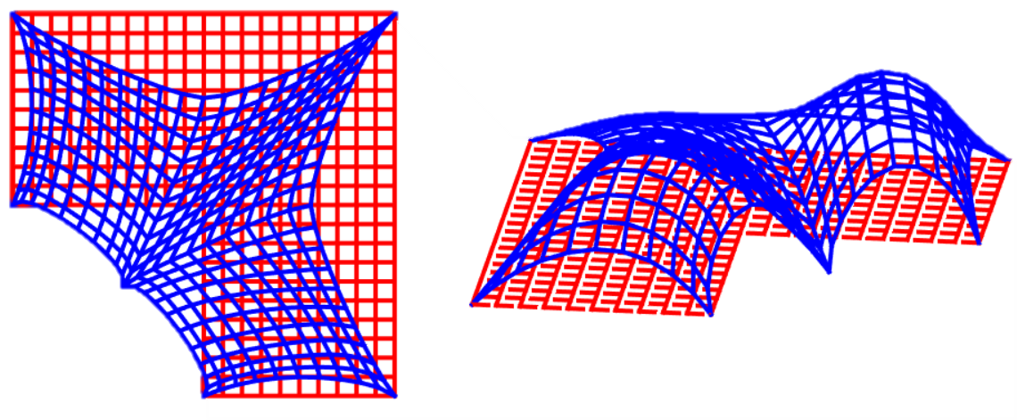
What if applied for shell form-finding?

Slide 7
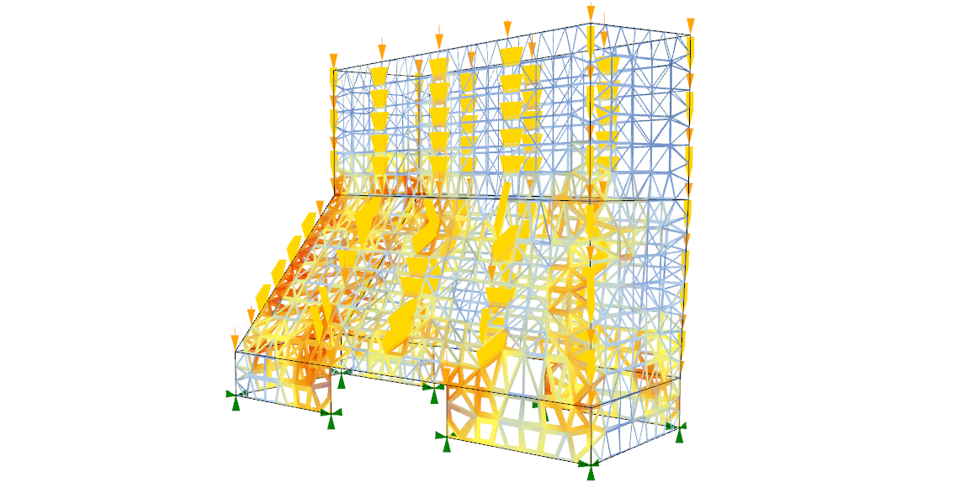
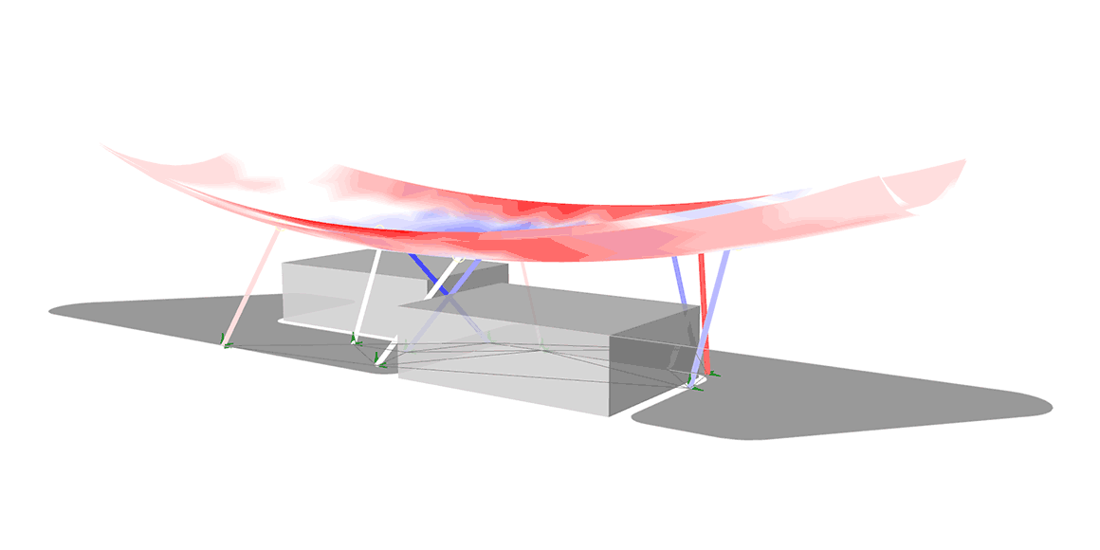
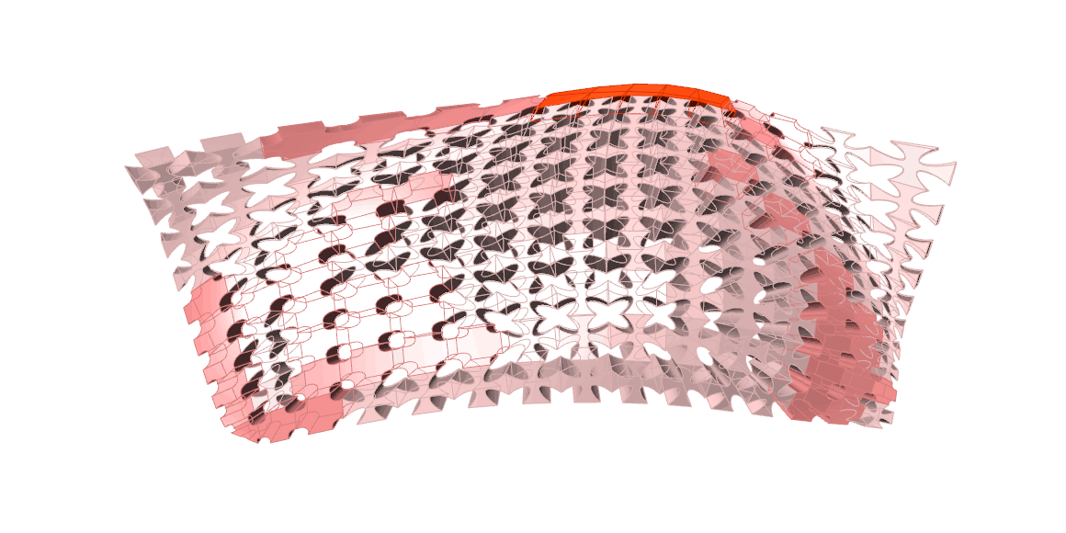
What if inside parametric environment?
Source: karamba3d.com

Slide 8
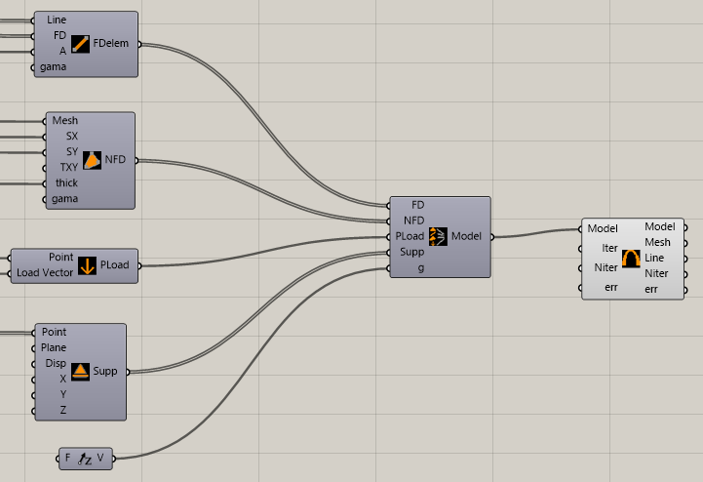
A new form-finding tool
Input data
Assemble model
Solve and output data

Slide 9
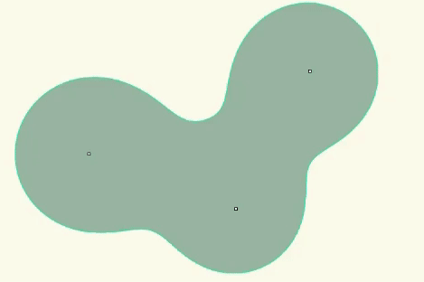
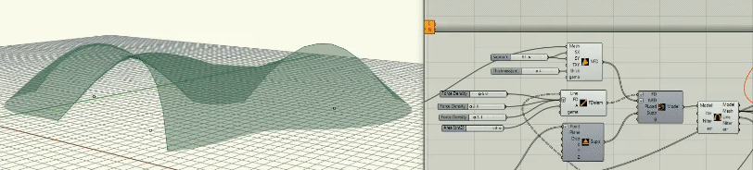
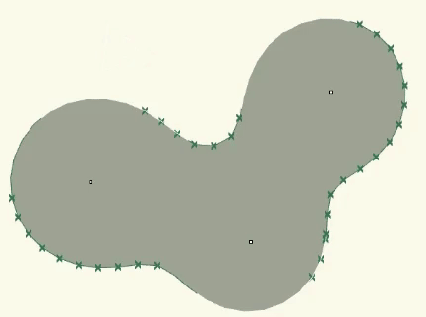

Slide 10
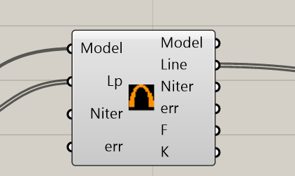
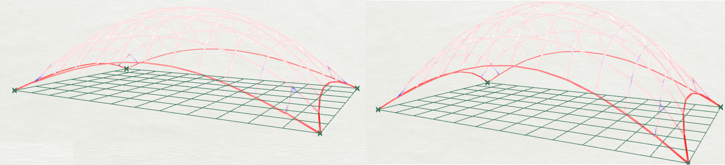
FDM design and optimization
From 2.5m
To 2.6m
To 2.7m

Slide 11
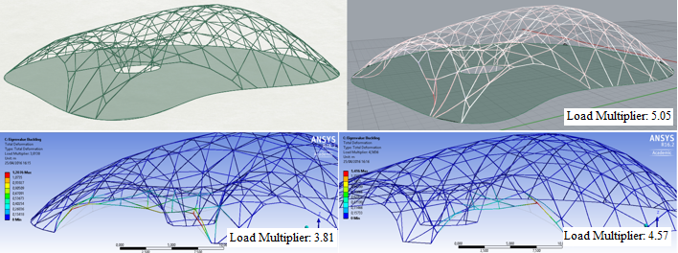
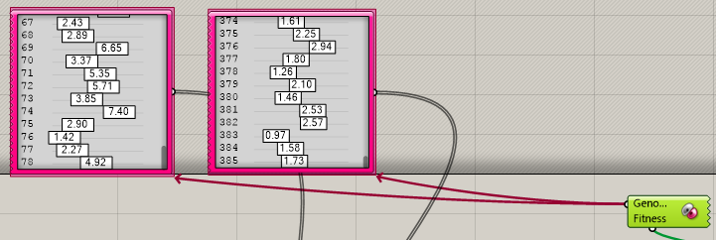
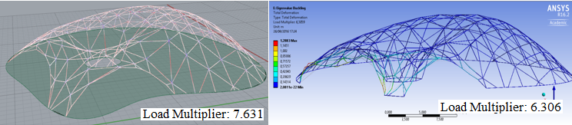
FDM design and optimization

Slide 12
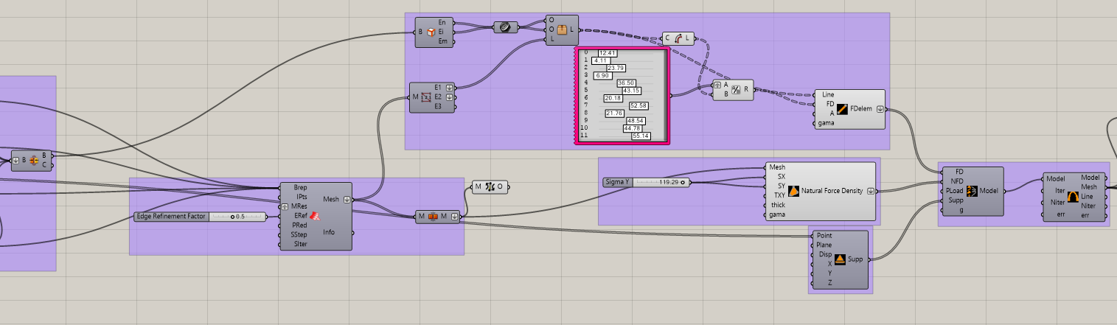
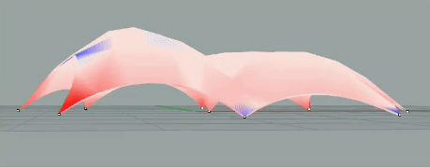
NFDM design and optimization

Slide 13
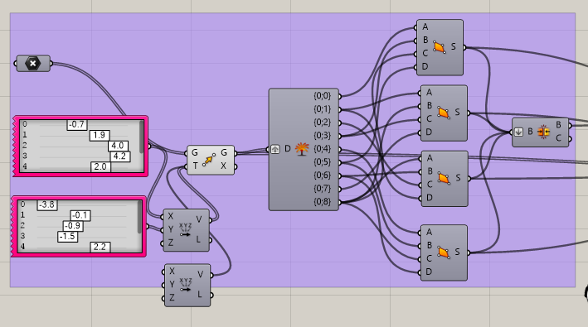
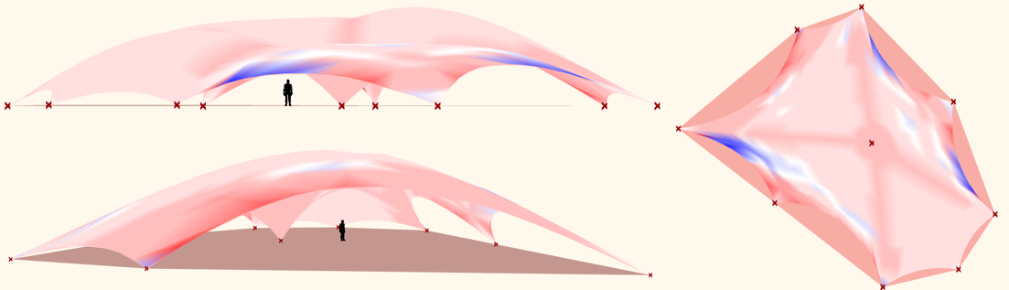
NFDM design and optimization

Slide 14
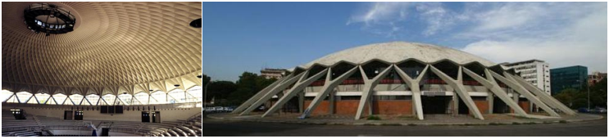
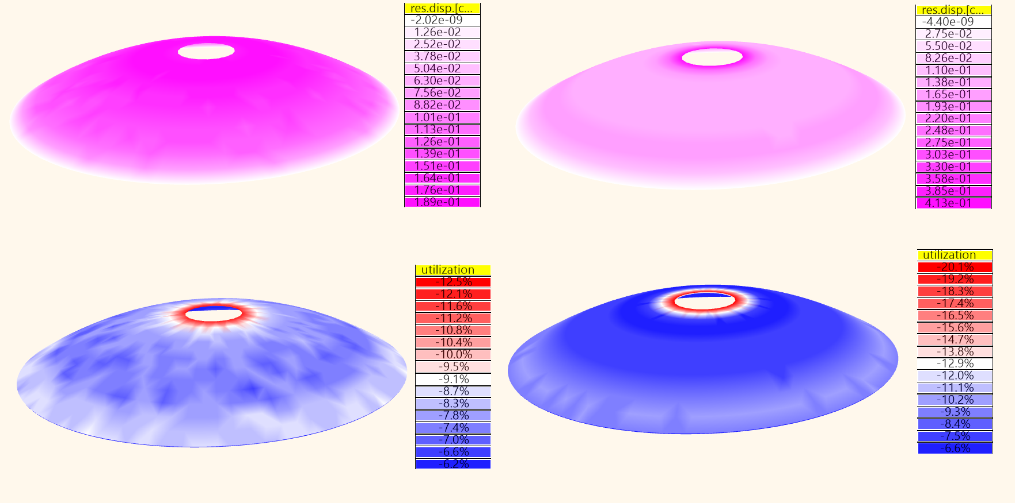
Best-fit Optimization

Slide 15
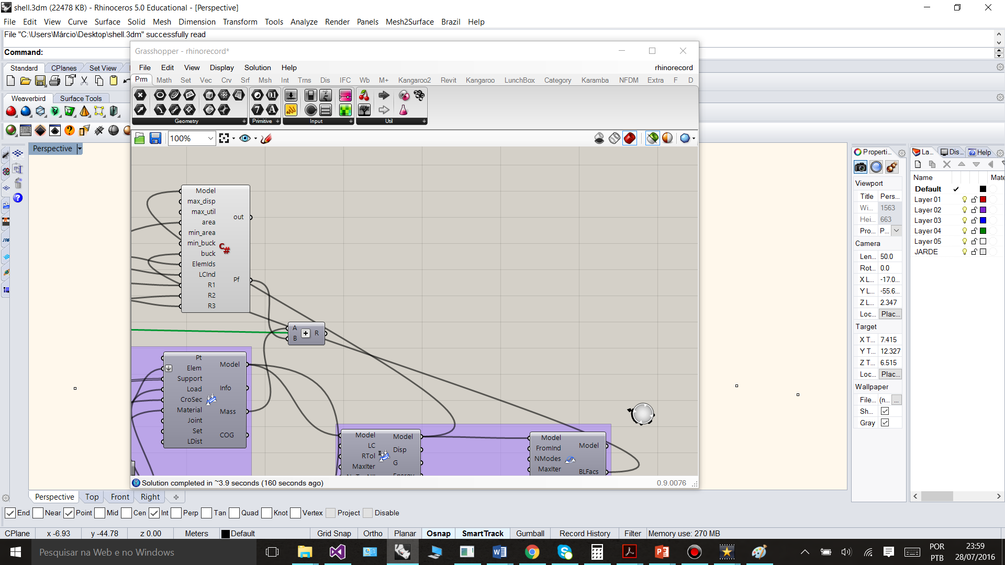
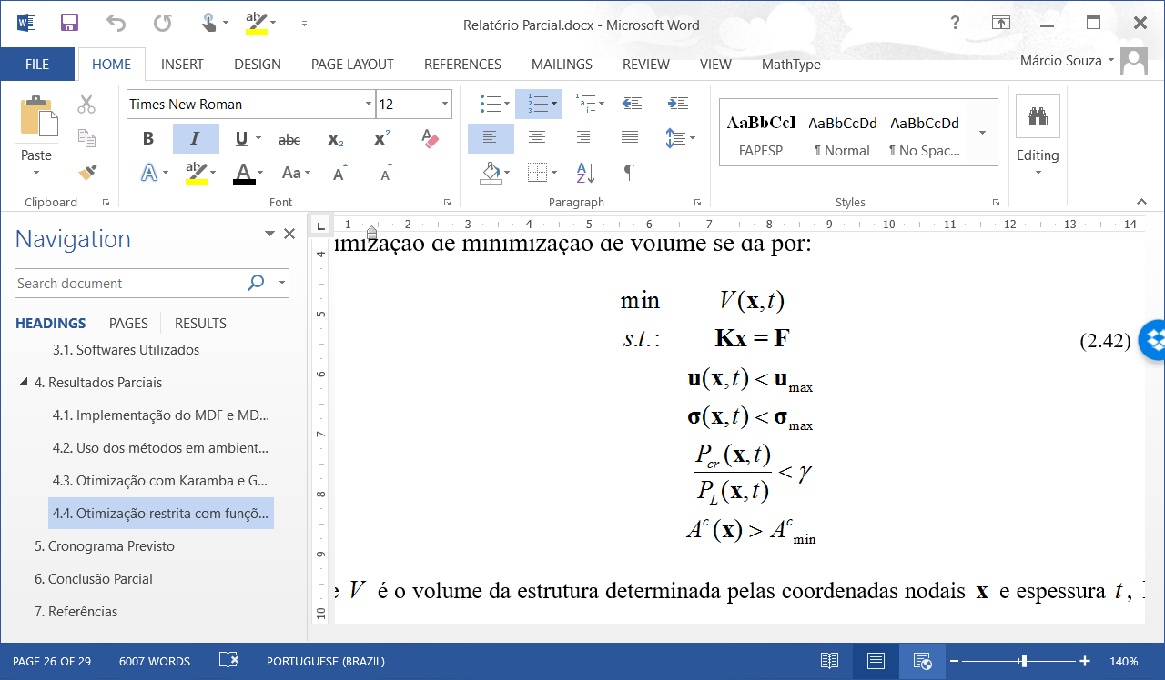
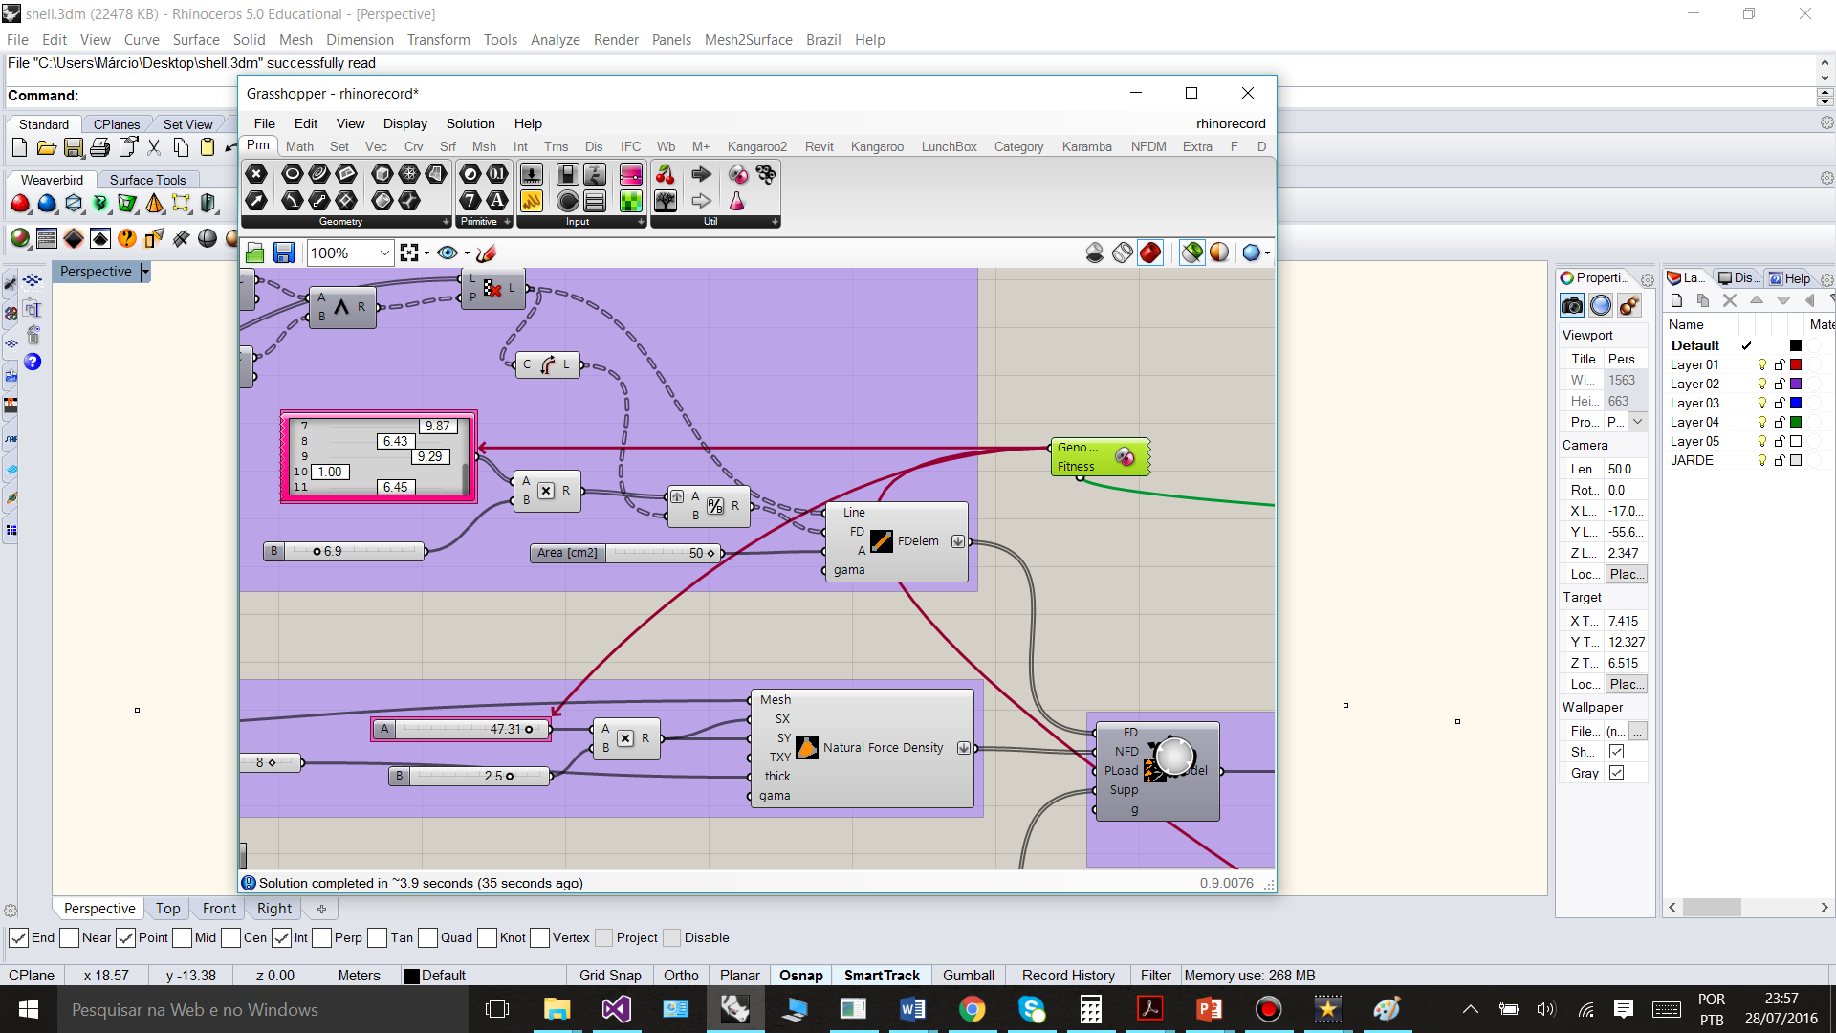
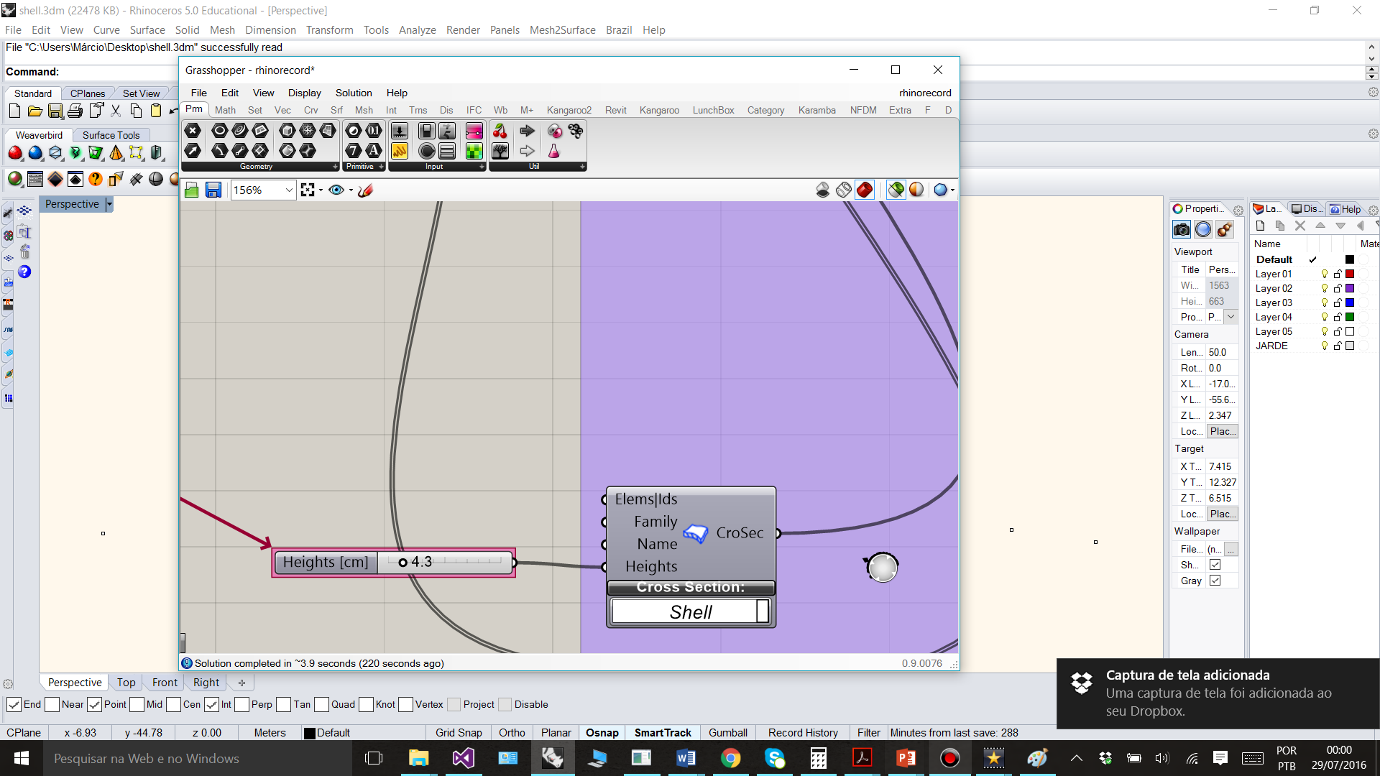
Constrained Optimization with Penalty Functions

Slide 16
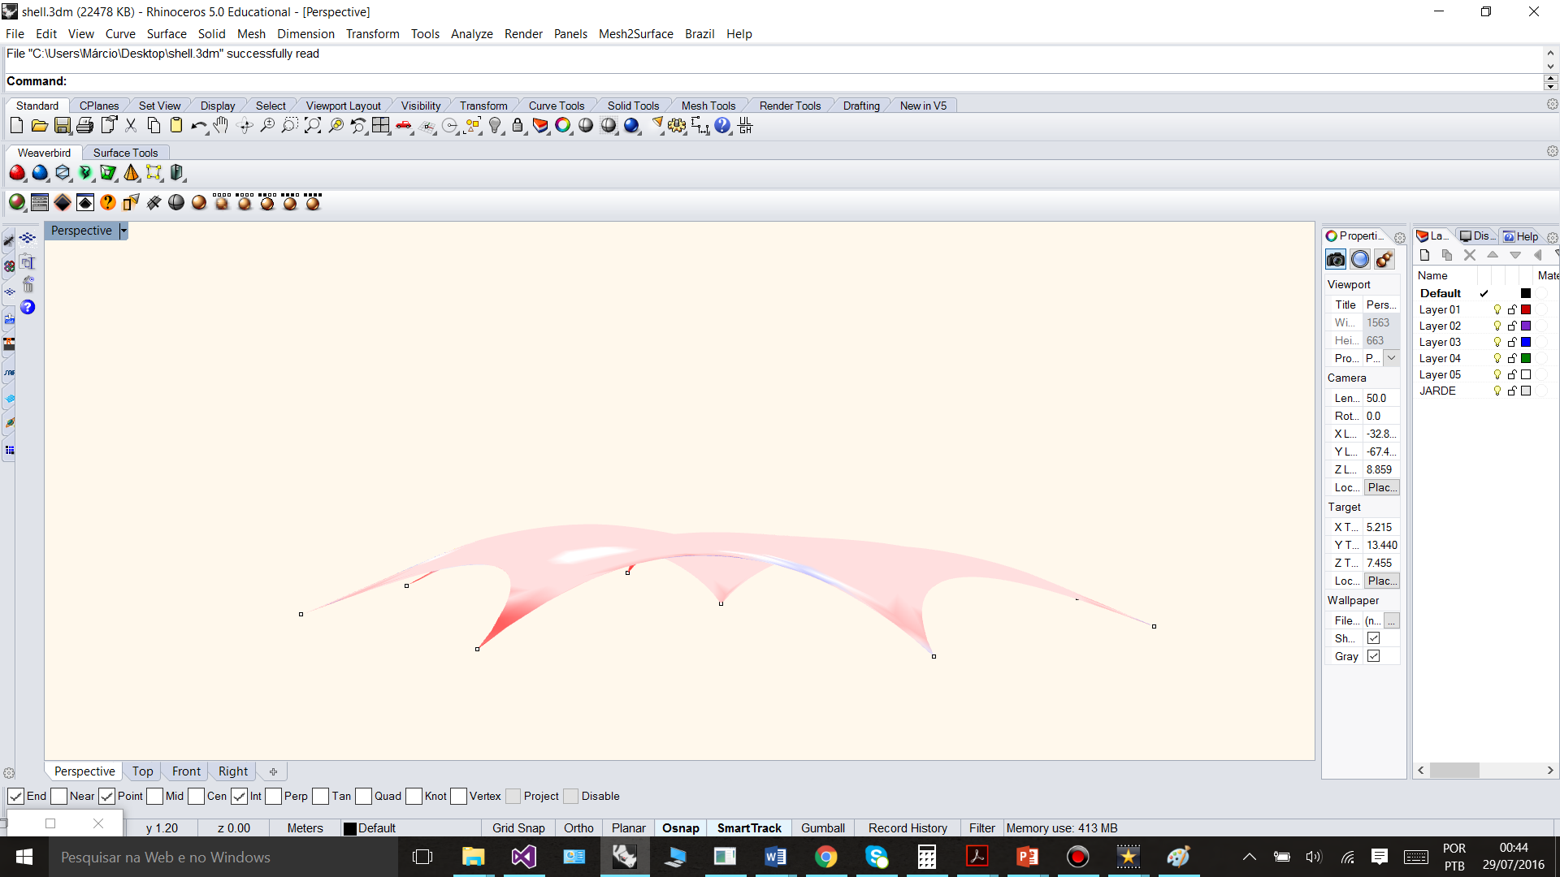
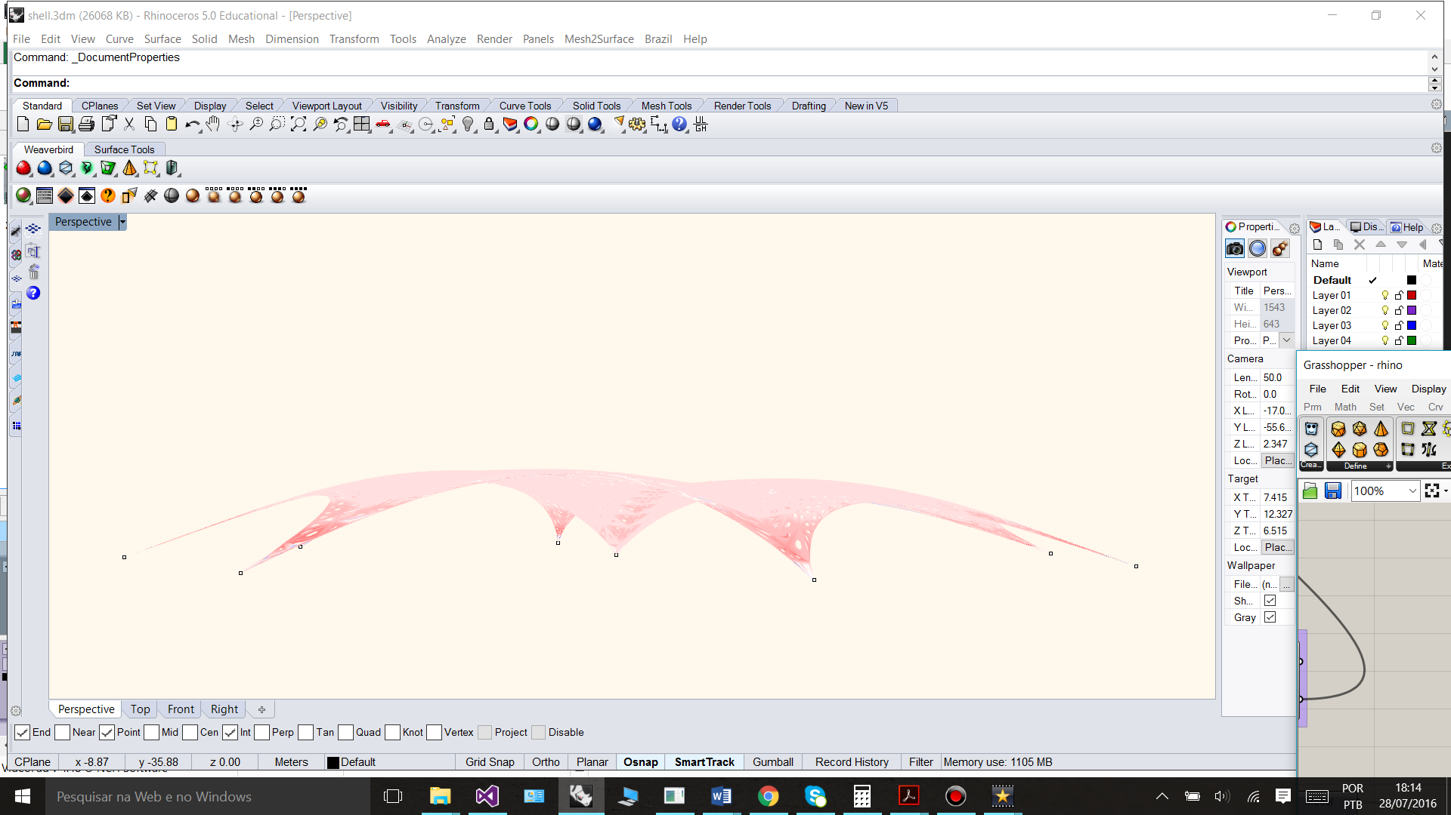
Constrained Optimization with Penalty Functions

Slide 17
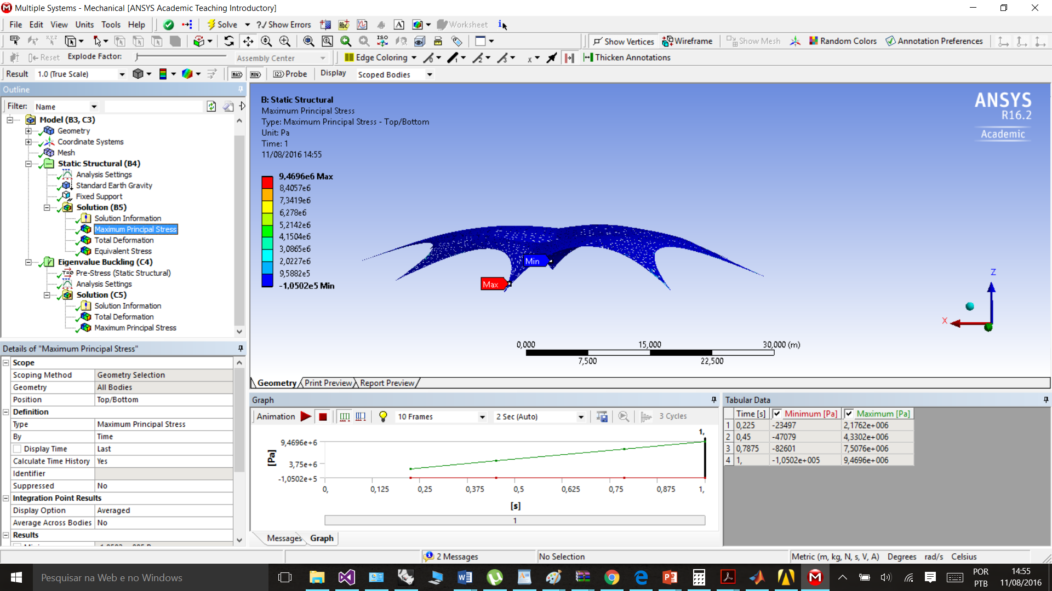
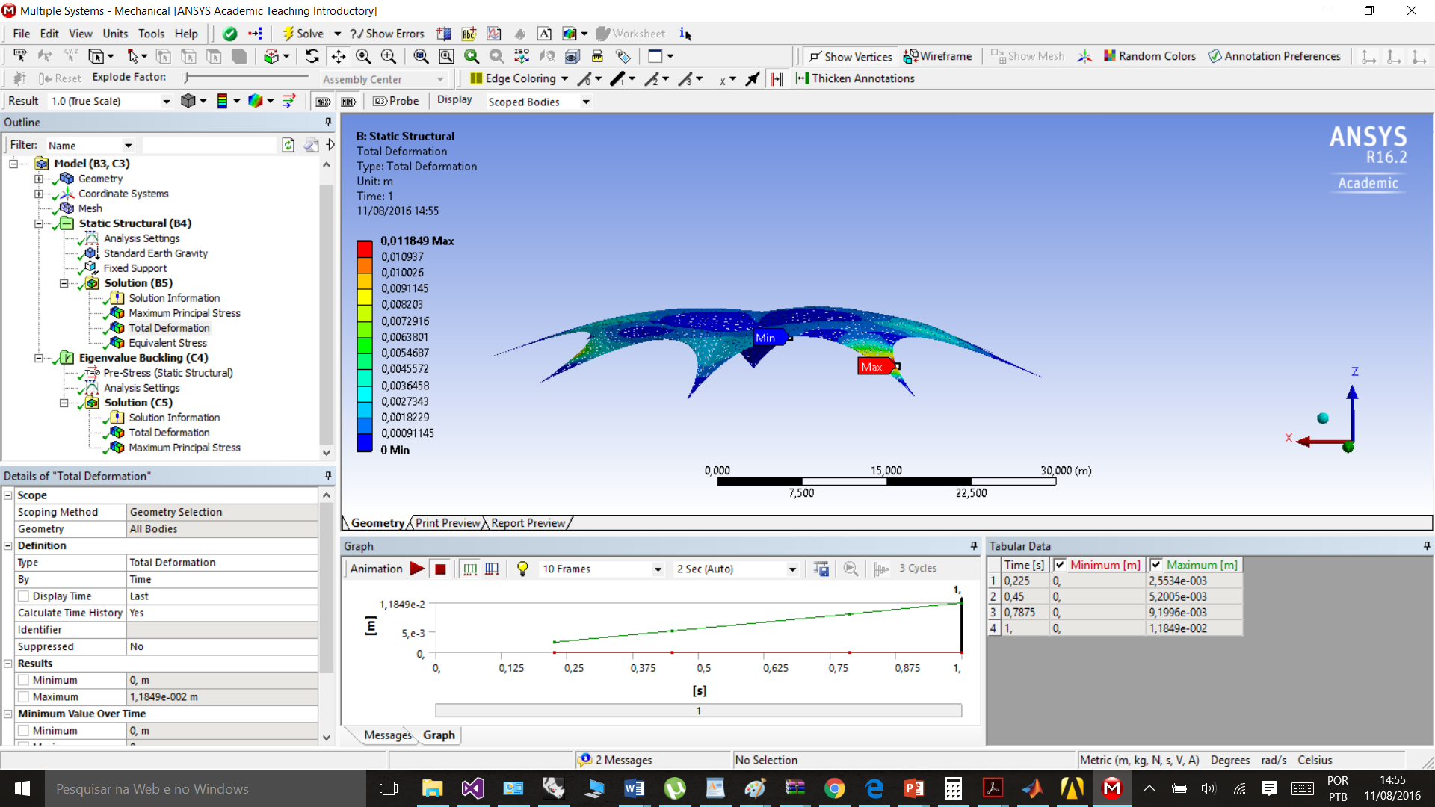
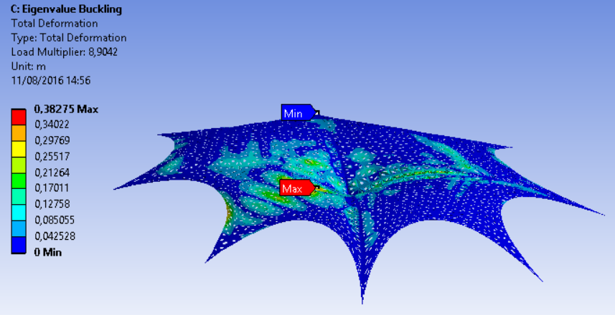
Constrained Optimization with Penalty Functions

Slide 18
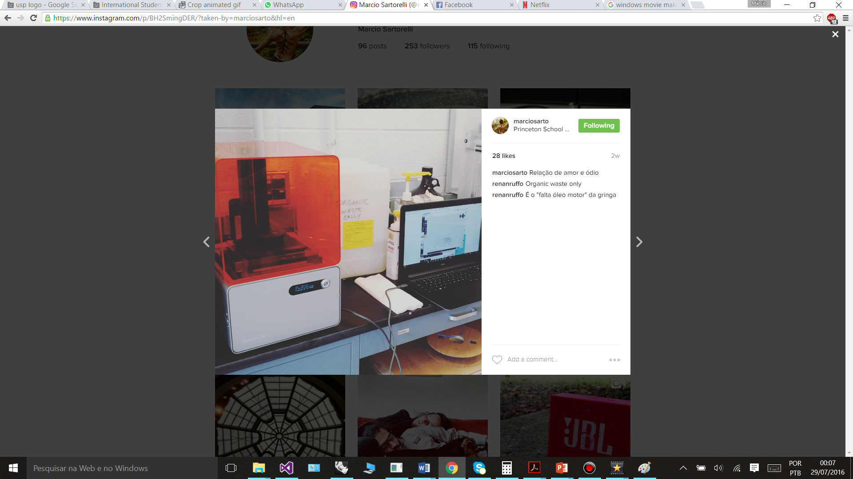

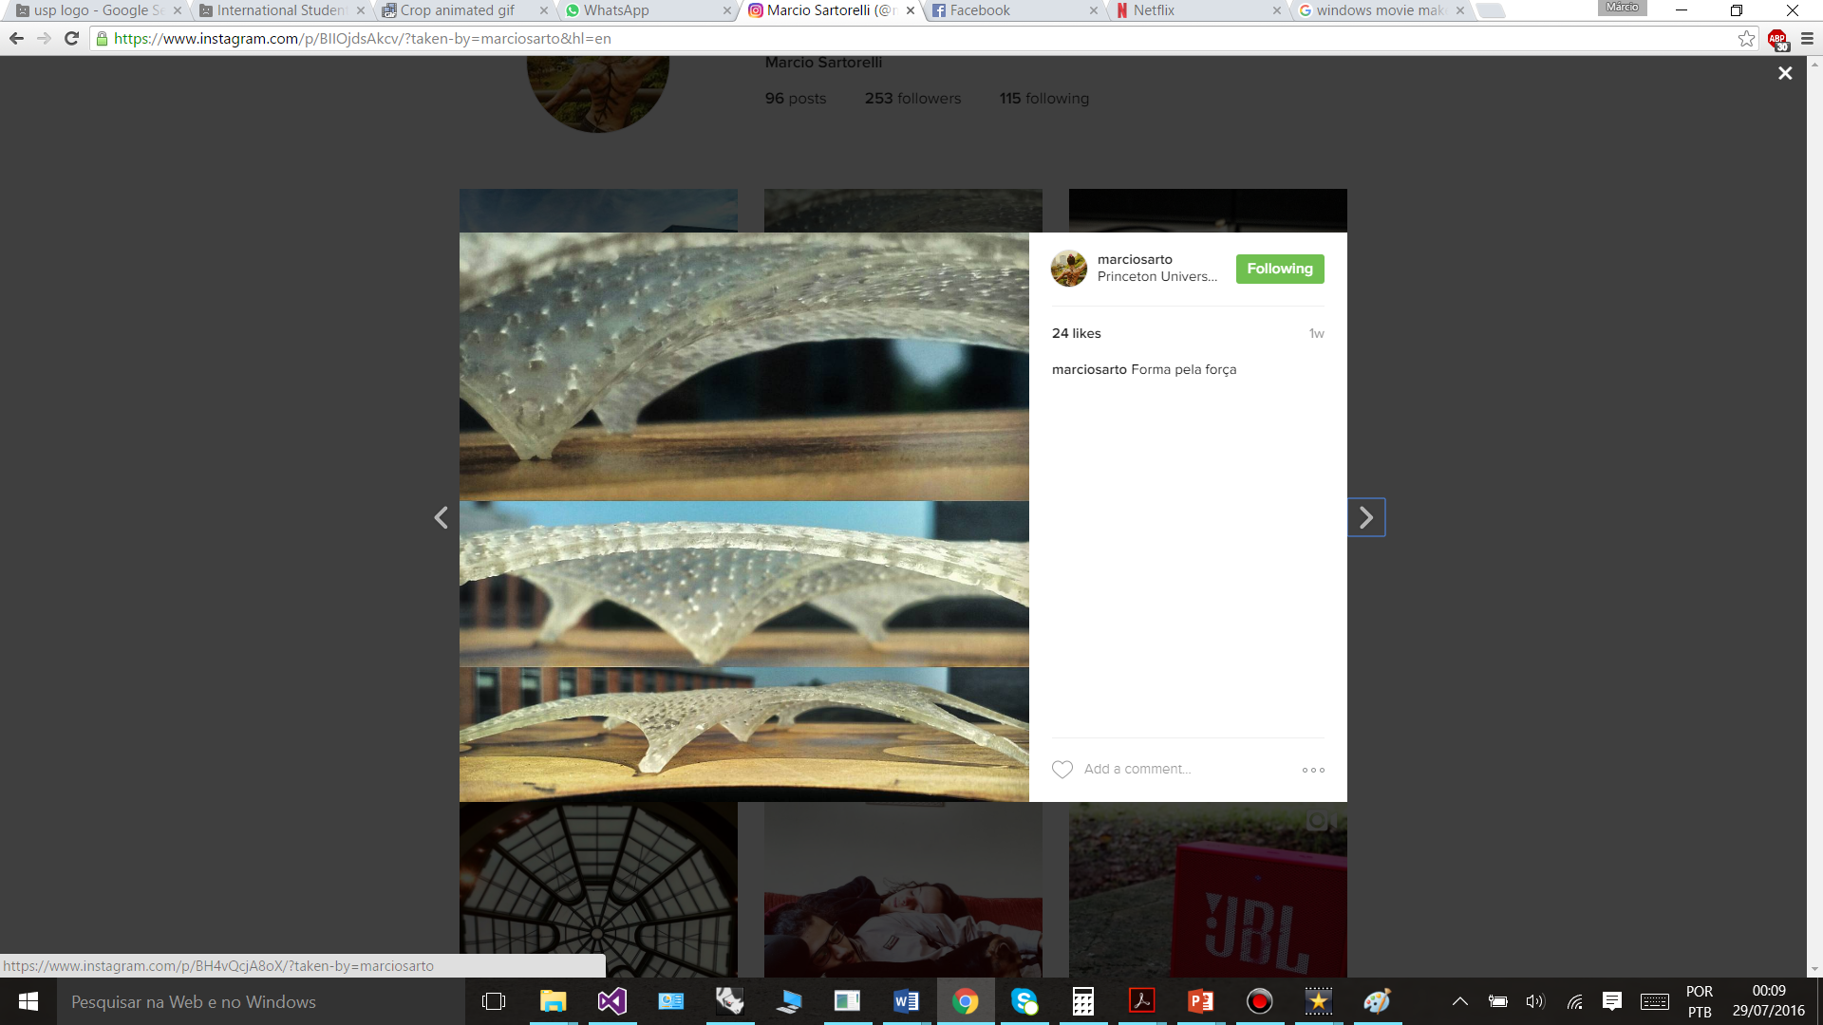
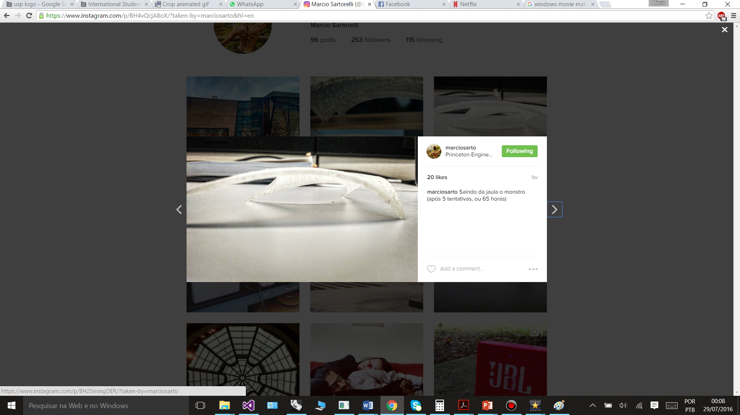

Slide 19
Some conclusions
The Natural Force Density Method showed to be a good form-finding tool for shells, and its integration with parametric tools adds up to the design process as it allows real-time geometrical and structural feedback, opening a large range of possibilities in definition of form-finding parameters.
Genetic algorithms for optimization showed to be easy to use and deliver good results associated with the FDM and the NFDM parameters. Definition of constraints with penalty functions worked well for structural and architectural specifications. Future works will analyse the potential of the tools developed inside muti-objective genetic algorithms.

Slide 20
Thank You!
marcio.sartorelli.souza@usp.br
paulleti@usp.br

